Slide 1



Slide 2
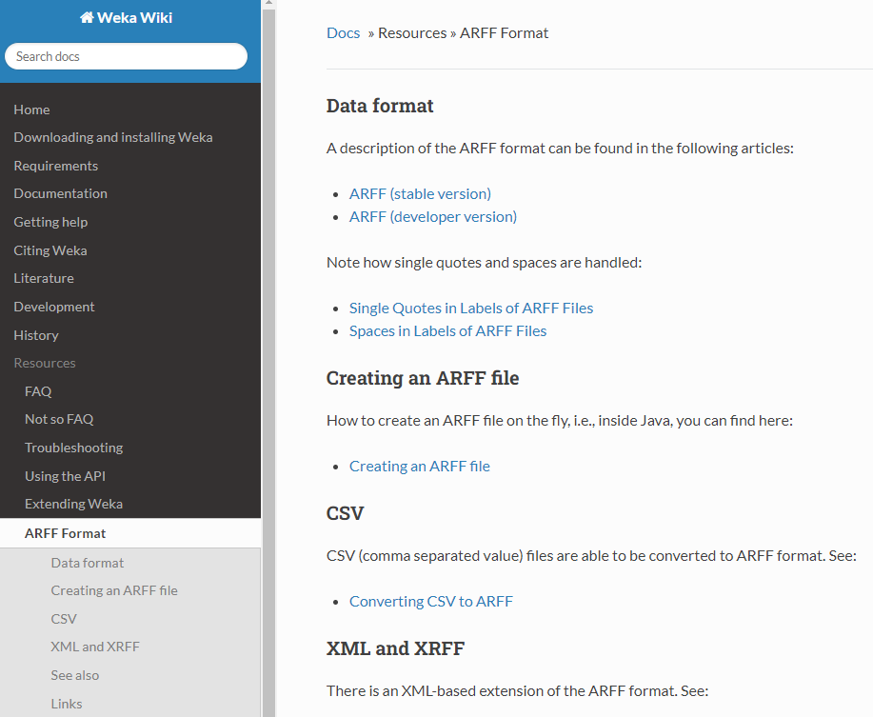

Slide 3
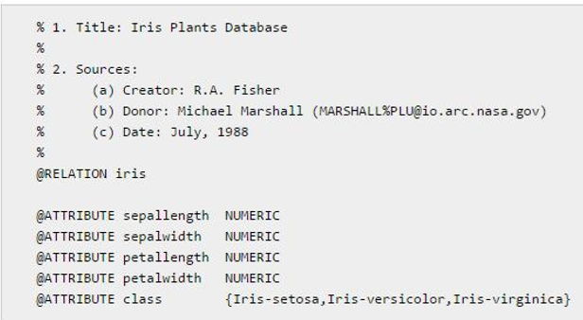
ARFF - Header
Relation : 可以自己取名，若名字中有空白必須加上<>
Attribute types:
  Numeric
  Nominal
  String
  Date [<date-format>]

Slide 4
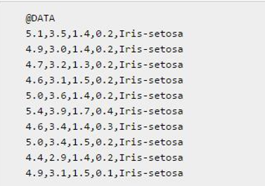
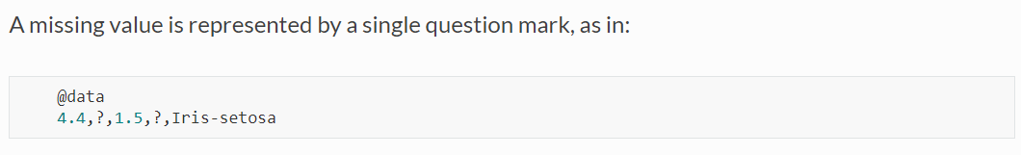
ARFF - Data
Dense Data:
Attribute values for each instance can be delimited by commas or tabs. The data corresponding to the nth @attribute declaration is always the nth field of the attribute.

Slide 5
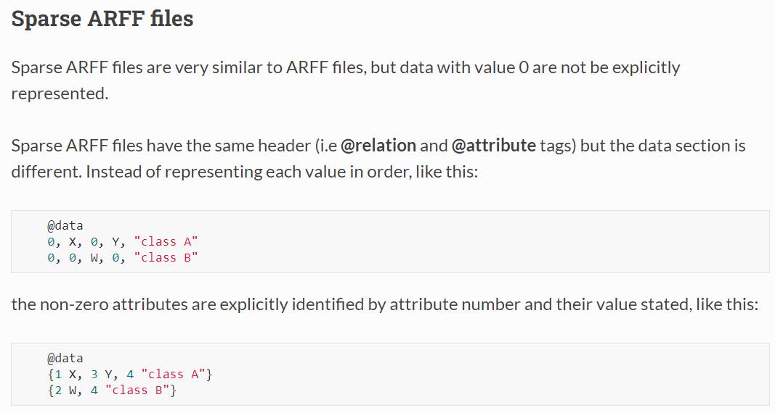
Notes:
Each instance is surrounded by curly braces, and the format for each entry is: [index] [space] [value] where index is the attribute index (starting from 0).
Note that the omitted values in a sparse instance are 0, they are not "missing" values! If a value is unknown, you must explicitly represent it with a question mark (?).

Slide 6
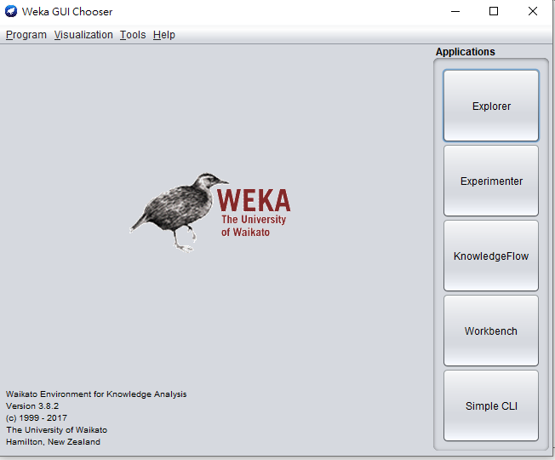
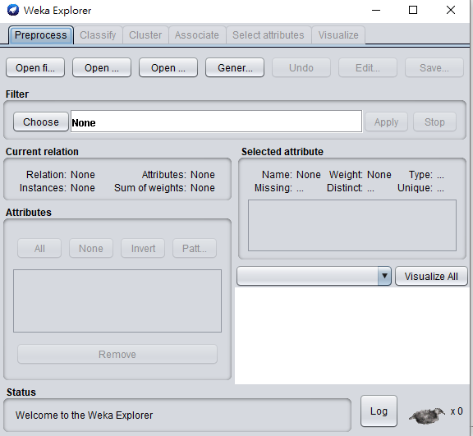
WEKA - GUI and Explorer

Slide 7
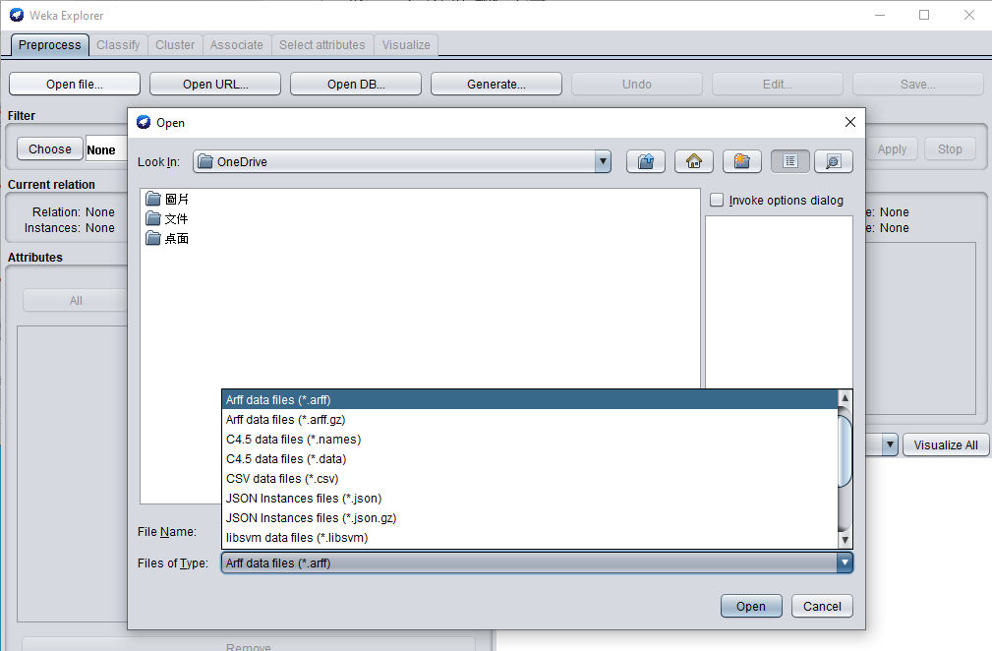
Specify the file type you want to import

Slide 8
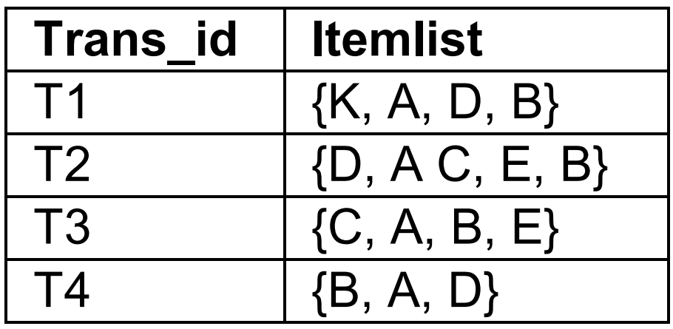
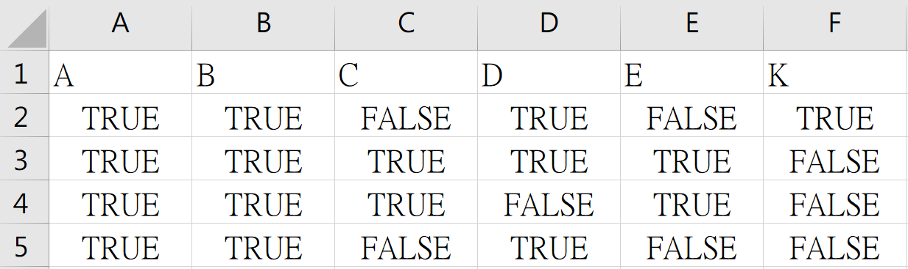
Try to analysis a toy example for sanity check

Slide 9
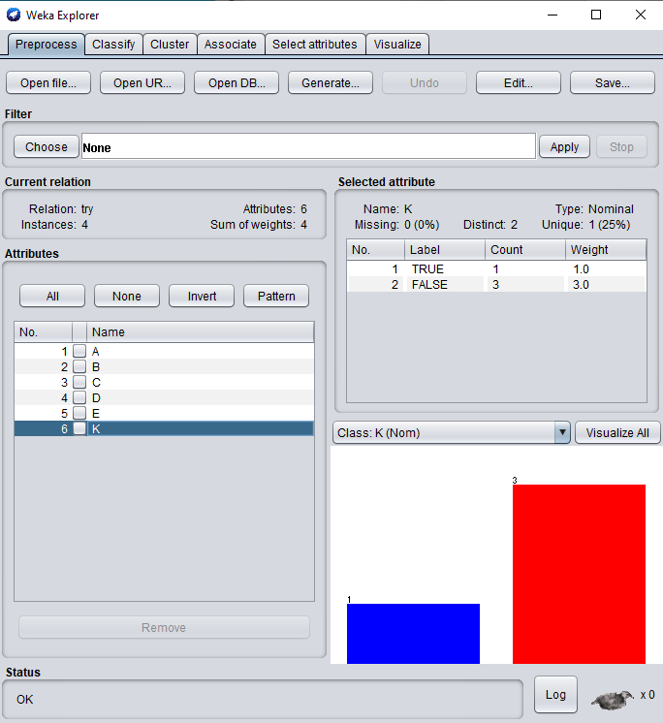
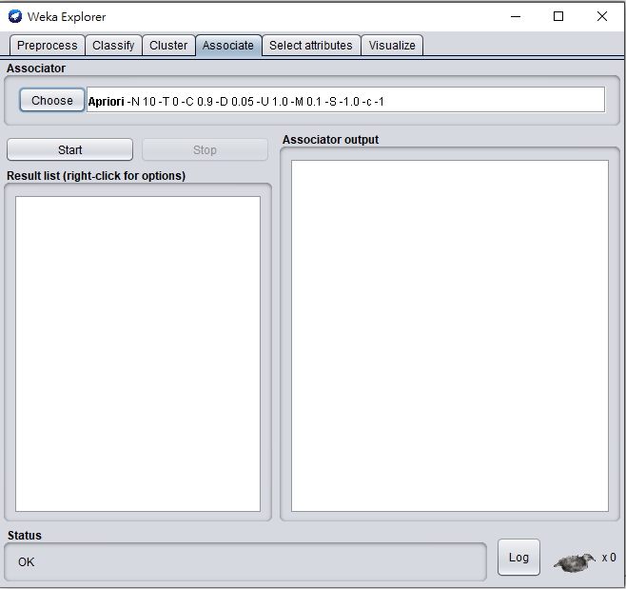
WEKA - Preprocess

Slide 10
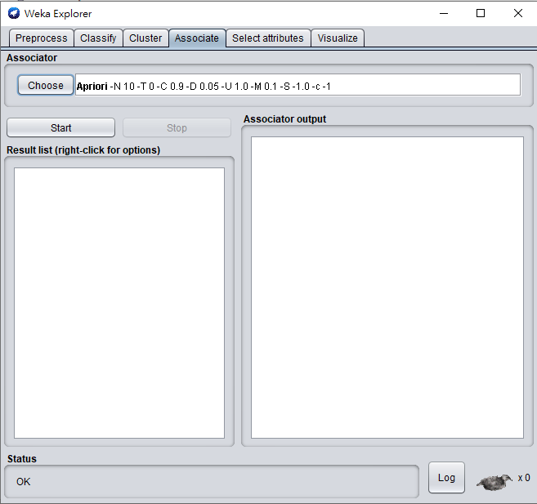
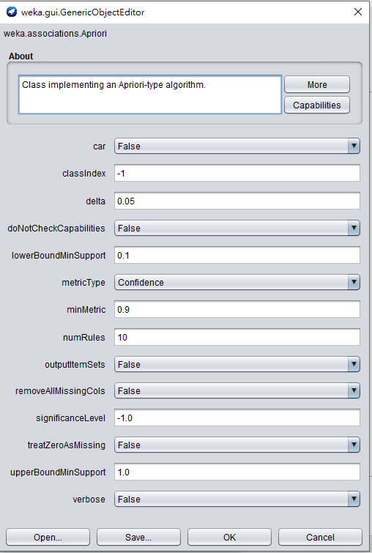
WEKA - Apriori parameters

Slide 11
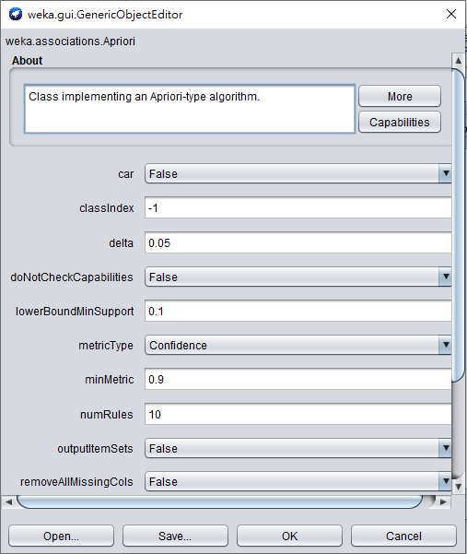
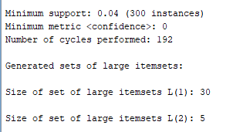
WEKA - Apriori parameters
class association rule(CAR): 指定被 imply 的 item
Delta: Iteratively decrease support by this factor
upperboundMinsupport:

Slide 12
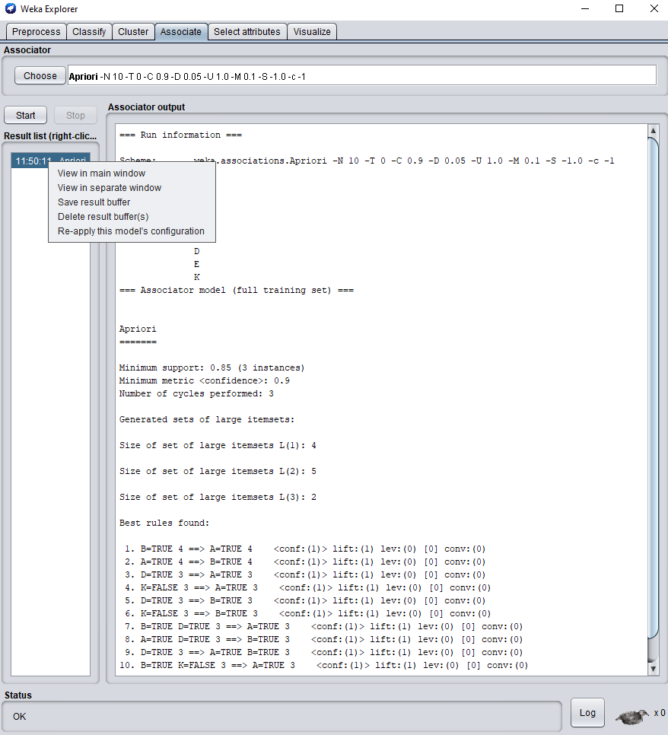
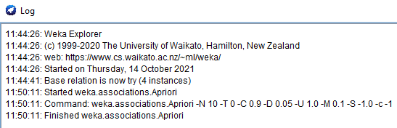
WEKA - Processing…

